Slide 1
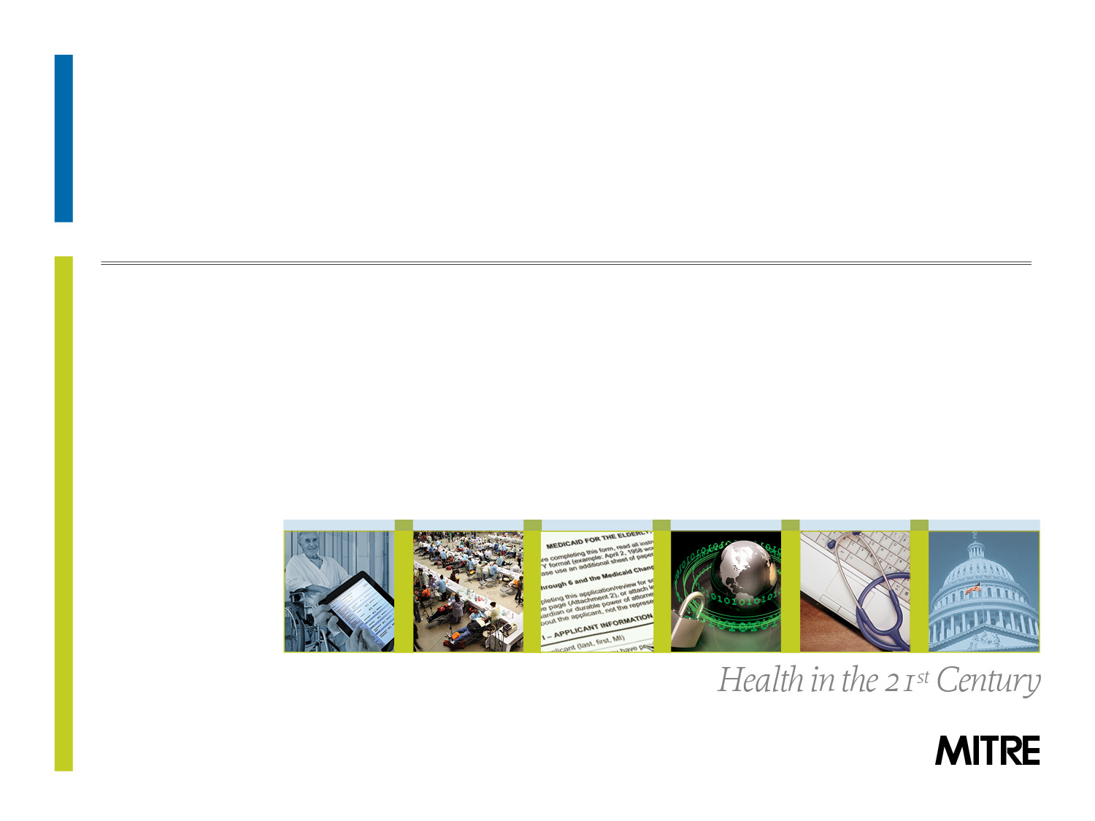

An Open Source Clinical Quality Modeling Framework

Slide 2

What is Kamira?
The Kamira project aims to assess the “quality” of a Clinical Quality Measure, considering 3 dimensions:
Complexity of a Clinical Quality Measure
Short-term costs and long-term savings associated with an individual Clinical Quality Measure
Availability of Clinical Patient Data required to drive Clinical Quality Measures
The Kamira project is internally funded by the MITRE Corporation Innovation Program
MITRE is a 501(c)(3) non-profit corporation chartered to work in the public interest
In September 2012, MITRE was competitively awarded the role as the first operator of the Center for Medicare and Medicaid Services (CMS) Health Federally Funded Research and Development Center (FFRDC)
Notes:
“The Value of Ambulatory Care Measures: A Review of Clinical and Financial Impact from an Employer/Payer Perspective” (June, 2008) www.ajmc.com .

Slide 3
Background - Clinical Quality Measures
What are Clinical Quality Measures (CQM)?
Tools that help us measure a segment of healthcare delivery
Each CQM has a different goal: effective, safe, efficient, patient-centered, equitable, and/or timely care
Clinical Quality Measures are key components of the Meaningful Use program as part of the HITECH Act
It is assumed that over time, addressing CQMs will result in:
Healthier outcomes for patients
Lower overall cost of care for the Nation
Notes:
“The Value of Ambulatory Care Measures: A Review of Clinical and Financial Impact from an Employer/Payer Perspective” (June, 2008) www.ajmc.com .

Slide 4


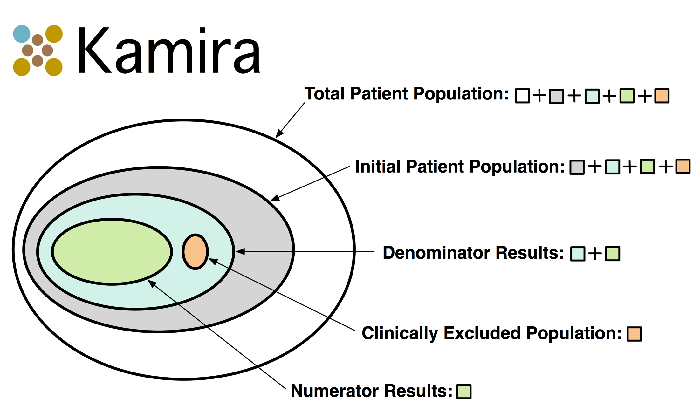
Clinical Quality Measures

Slide 5
Research Questions
What are the best methods to assess the overall value of a Clinical Quality Measure?
If the performance of a Clinical Quality Measure improves, how does it affect overall health outcomes? How does it affect total cost to the healthcare system?
What are the best Clinical Quality Measures that improve the performance of other sibling Clinical Quality Measures?
Notes:
“The Value of Ambulatory Care Measures: A Review of Clinical and Financial Impact from an Employer/Payer Perspective” (June, 2008) www.ajmc.com .

Slide 6
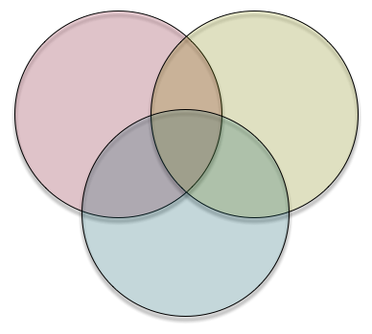
Idea
Availability of Clinical Patient Data
Clinical Quality Measures
Healthcare
Financial Models
The most value to the healthcare system

Slide 7
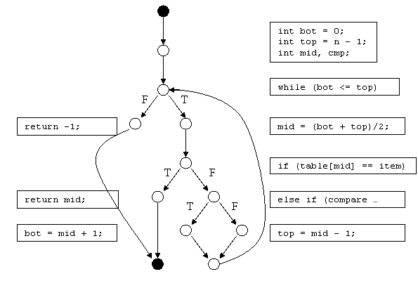
Cyclomatic Complexity Analysis
Cyclomatic Complexity (CC) is a software metric used to gauge the complexity of source code
CC measures the number of linearly independent paths through the source code of a function
Simple example function where “CC” = 4
http://www.whiteboxtest.com/cyclomatic-complexity.php
Notes:
Cyclomatic Complexity a metric adopted by NIST and used for decades to assess the complexity of algorithms and software systems and to ensure software quality and implement-ability

Slide 8
Cyclomatic Complexity Analysis
Ideal metric to apply to assess the quality of software source code
Provides visibility into maintainability of software source code, agnostic of any particular programming language
The ranges that constitute acceptable values on software Cyclomatic Complexity is a decades-long and ongoing topic with computer scientists
Carnegie Mellon University (CMU):
Cyclomatic Complexity | Risk Evaluation
1-10 | Very simple; low risk
11-20 | Nominal; moderate risk
21-50 | Complex; high risk
>50 | Untestable; extremely high risk
www.sei.cmu.edu/reports/97hb001.pdf (see page 147)

Slide 9
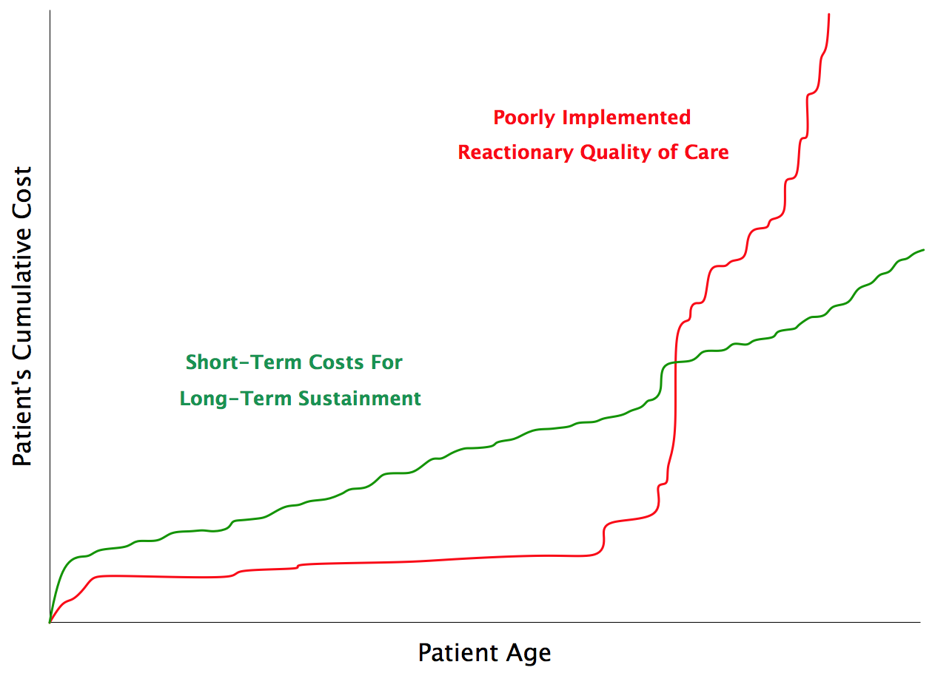
Using Clinical Quality Measures to Bend the Cost Curve
NOTIONAL
NOTIONAL

Slide 10
Model Financial Costs and Savings
Predicting short-term cost increases associated with improvements in CQM performance
The majority of the CQMs provide opportunities for providers to take action
Laboratory Test
Procedures
Medications
Etc.
CMS claims-based data contains upper bounds on provider compensation to address CQMs
Kamira will identify a short-term cost associated with addressing gaps in care with the Clinical Quality Measures
Future plans for Kamira: Forecasting cost savings by addressing improvements in the CQMs

Slide 11
Example: Influenza Vaccination
Measure | Description | Short Term Cost (Influenza Vaccination) | Cost per Hospitalized Case, ages 50-64 | Cost per Hospitalized Case, ages ≥ 65
NQF 0041 | Influenza Immunization for Patients > 50 Years Old | ~$15 per person | $7,276 (± 25%) | $8,278 (± 25%)
 |  | Current | Future
In 2010, Influenza/Pneumonia ranked as the 9th cause of death (50,000 deaths)
One third of all Americans 50–64 years of age have one or more chronic medical condition that puts them at increased risk for serious flu complications
Among the elderly, influenza vaccines can prevent 50 percent–60 percent of hospitalizations and 68 percent of deaths from flu-related complications
Achieving 90 percent vaccination coverage would reduce deaths by over 15,000 annually in a year with an average flu season (i.e., not a major epidemic)
Notes:
References:
Maciosek, Michael, Leif Solberg, Ashley Coffield, Nichol Edwards, and Michael Goodman. “Influenza Vaccination: Health Impact and Cost Effectiveness Among Adults Aged 50 to 64 and 65 and Older.” American Journal of Preventive Medicine 31, no. 1 (2006): 72–79.
“National Vital Statistics Report” 60, no. 4. Deaths: Preliminary Data for 2010 (January 11, 2012). http://www.cdc.gov/nchs/data/nvsr/nvsr60/nvsr60_04.pdf.
“The State of Health Care Quality”. National Committee for Quality Assurance, 2010. http://www.ncqa.org/portals/0/state%20of%20health%20care/2010/sohc%202010%20-%20full2.pdf.

Slide 12
Availability of Clinical Patient Data
Current requirements for clinical attributes in continuity of care standards do not match required attributes for calculating CQMs
CQMs often contain a super-set of the clinical attributes provided in continuity of care XML standards
Examples include the C32, CCDA, and CCR XML formats
Current shortcomings of this clinical data problem are optional attributes which could be generated by EHR systems
Medications
Immunizations
Allergies
Tobacco Use
Etc.
This activity will include the development of a model that will detail the availability of these clinical attributes through data collected from operational health IT sites

Slide 13
Idea
Availability of Clinical Patient Data
Clinical Quality Measures
Model Financial Costs and Savings with CQMs

Slide 14
Open Source License
The Kamira software is freely available via an Apache 2.0 Open Source distribution license
http://www.apache.org/licenses/LICENSE-2.0.html
Apache 2.0 is very industry-friendly and permissive for integrators
Apache 2.0 provides numerous freedoms on the use of Kamira software source code
Use, integration, modification, and re-distribution of the Kamira software source code is allowed, as long as attribution is also provided
MITRE is reviewing options to extend the Apache 2.0 license to include information on usage (to allow us to better align our research with community needs)

Slide 15
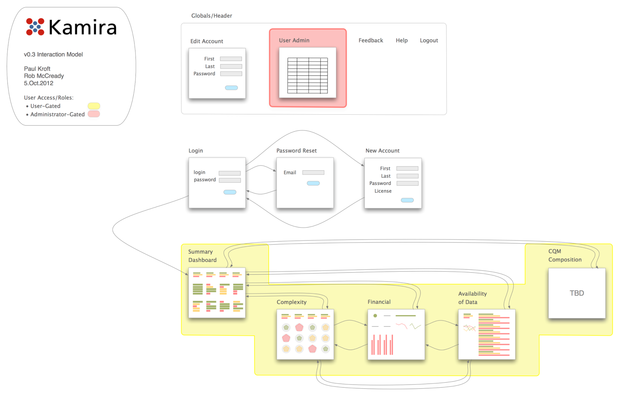
Interaction Model

Slide 16
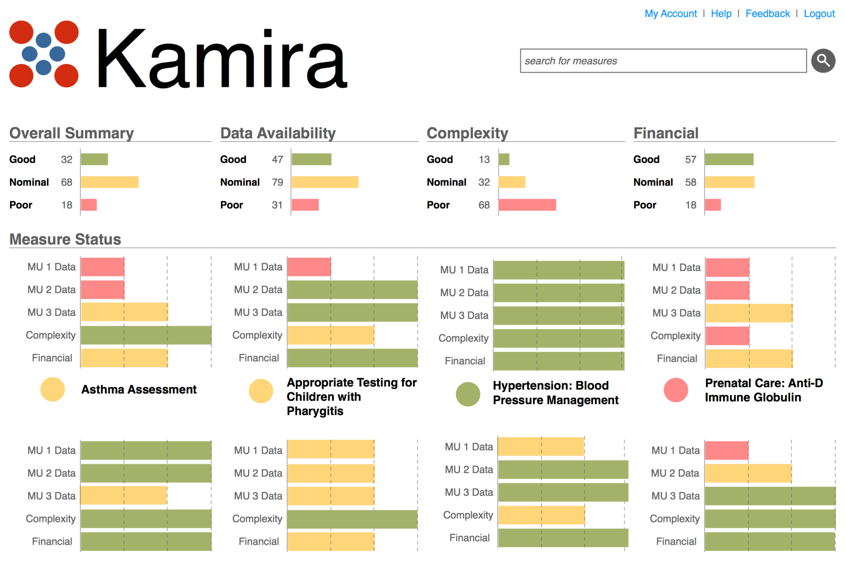
Dashboard Visualization

Slide 17
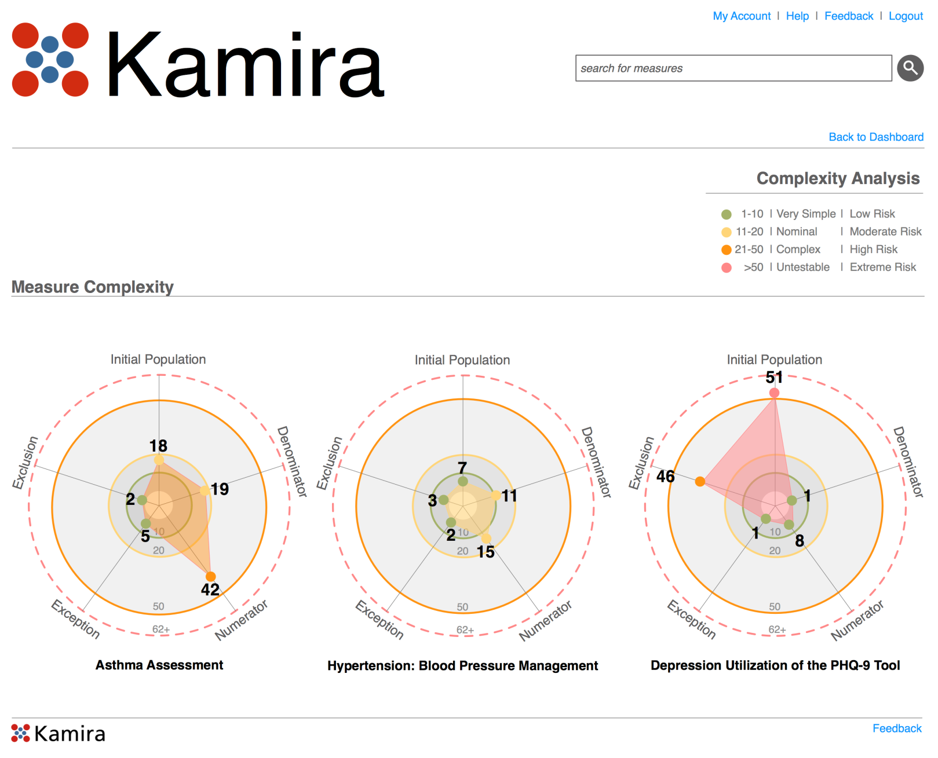
CQM Complexity Analysis Visualization

Slide 18
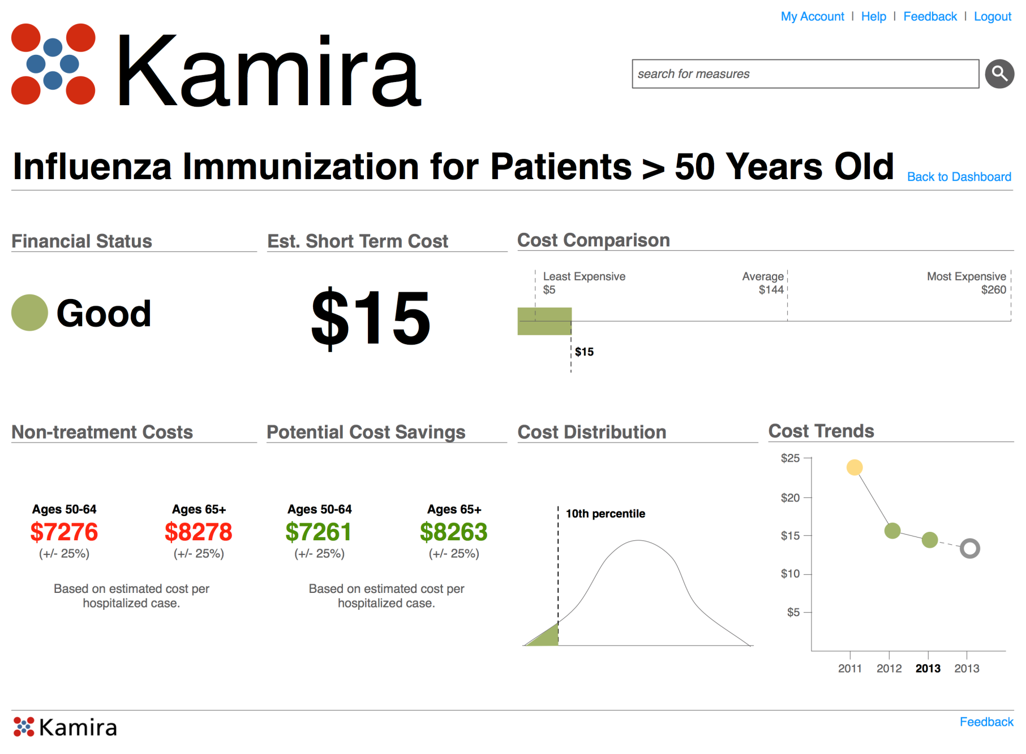
Financial Analysis Visualization

Slide 19
Backup

Slide 20
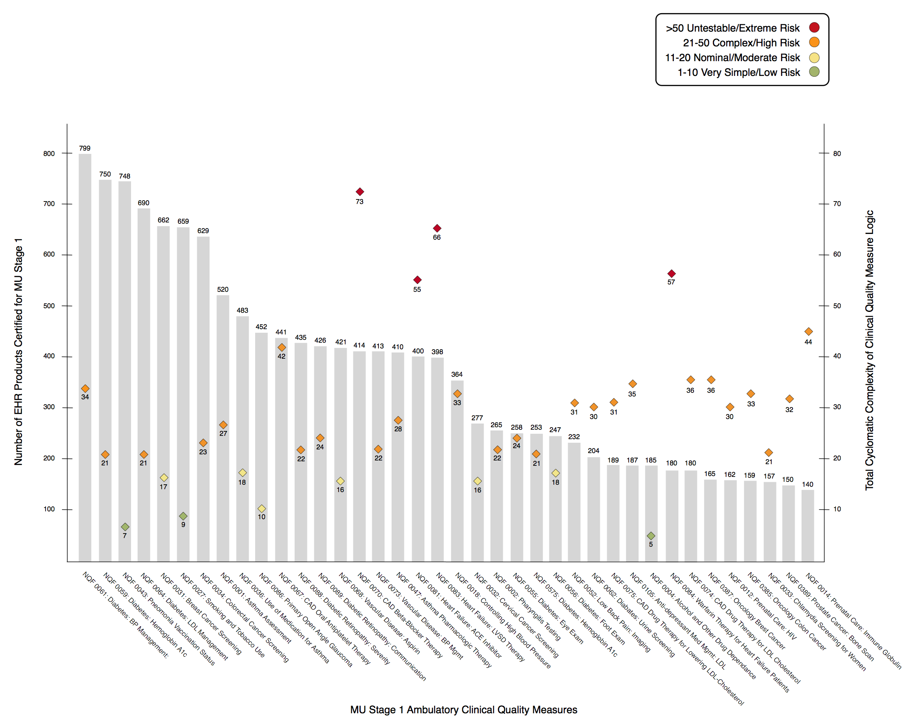
MU Stage 1 Ambulatory CQM Certification Analysis

Slide 21
Meaningful Use Stage 2 Ambulatory CQM Complexity Analysis

Slide 22
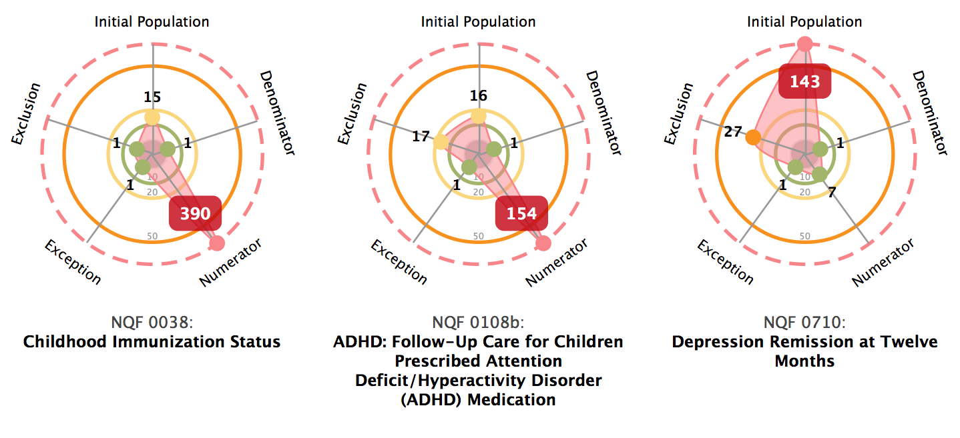
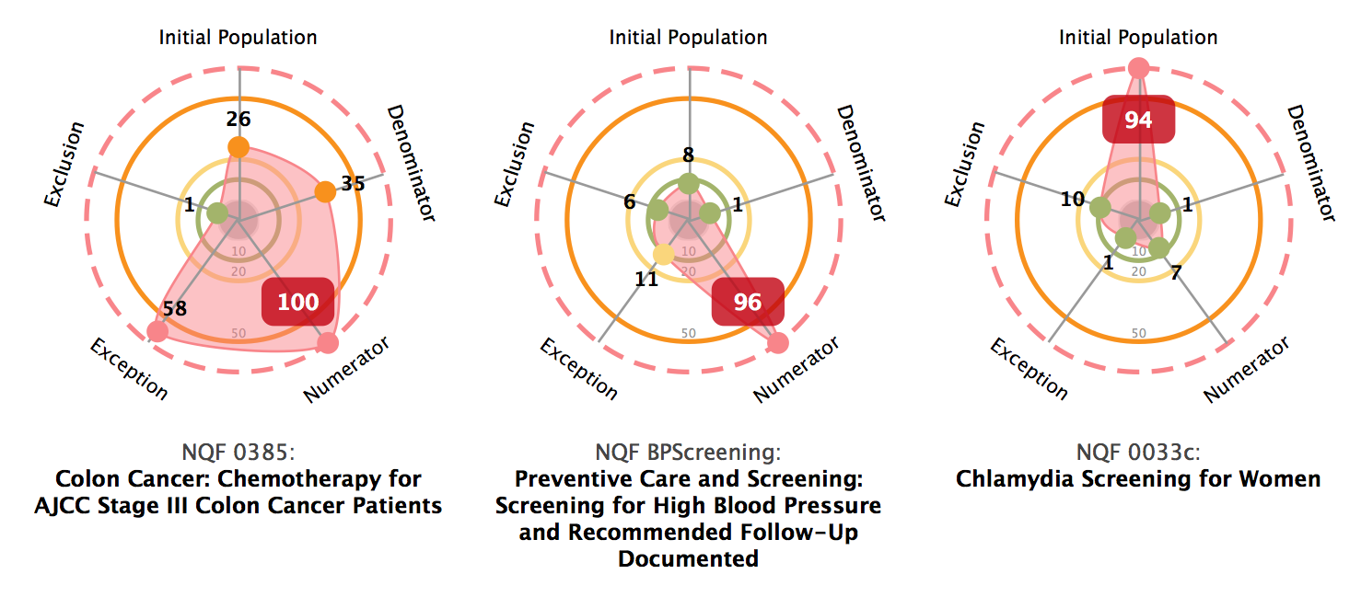
MU Stage 2 Cyclomatic Complexity Results

Slide 23
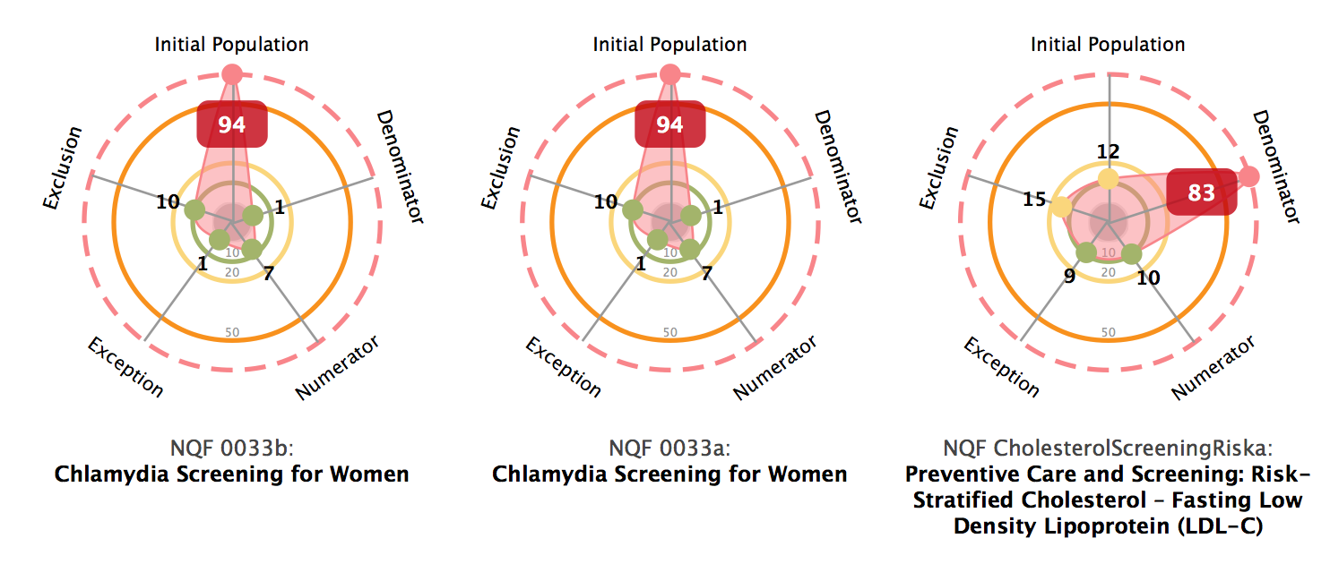
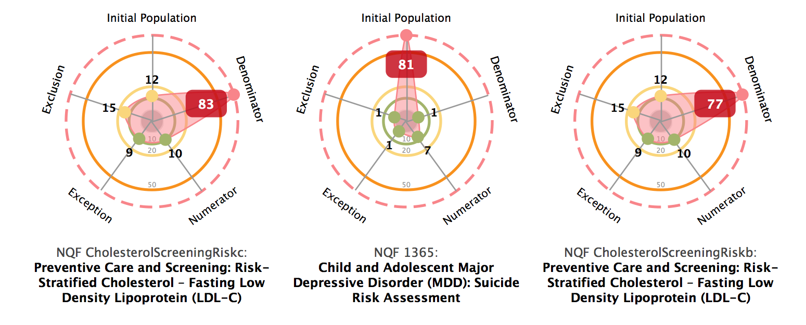
MU Stage 2 Cyclomatic Complexity Results

Slide 24
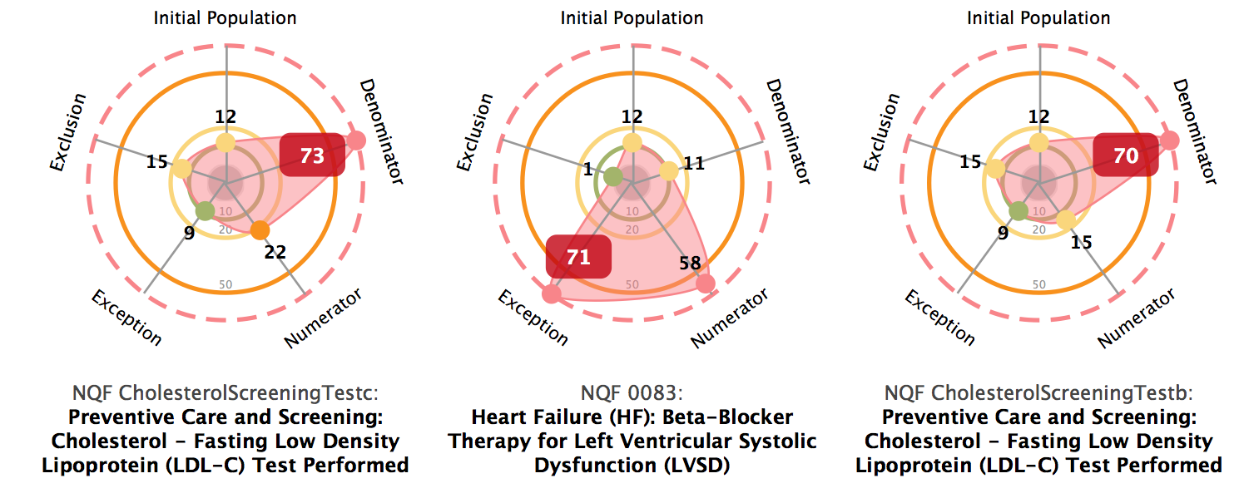
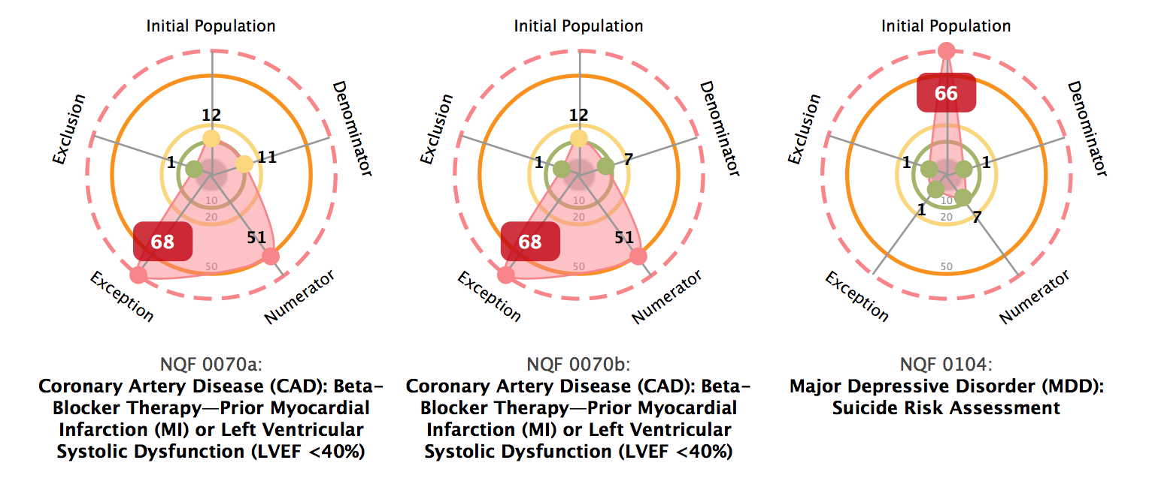
MU Stage 2 Cyclomatic Complexity Results

Slide 25
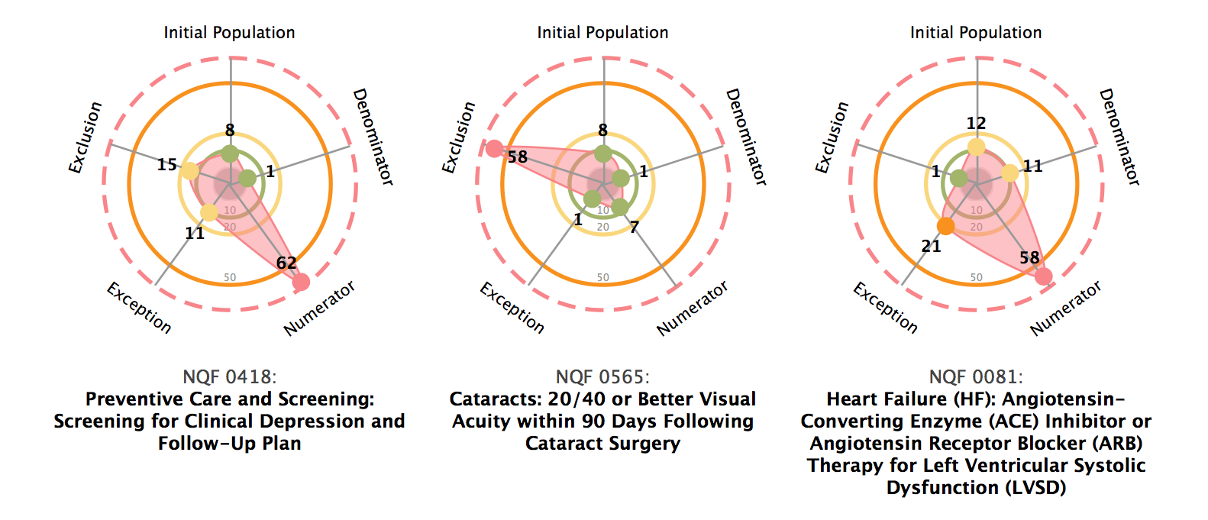
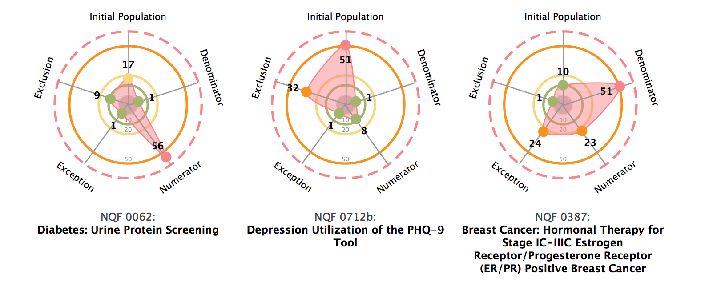
MU Stage 2 Cyclomatic Complexity Results

Slide 26
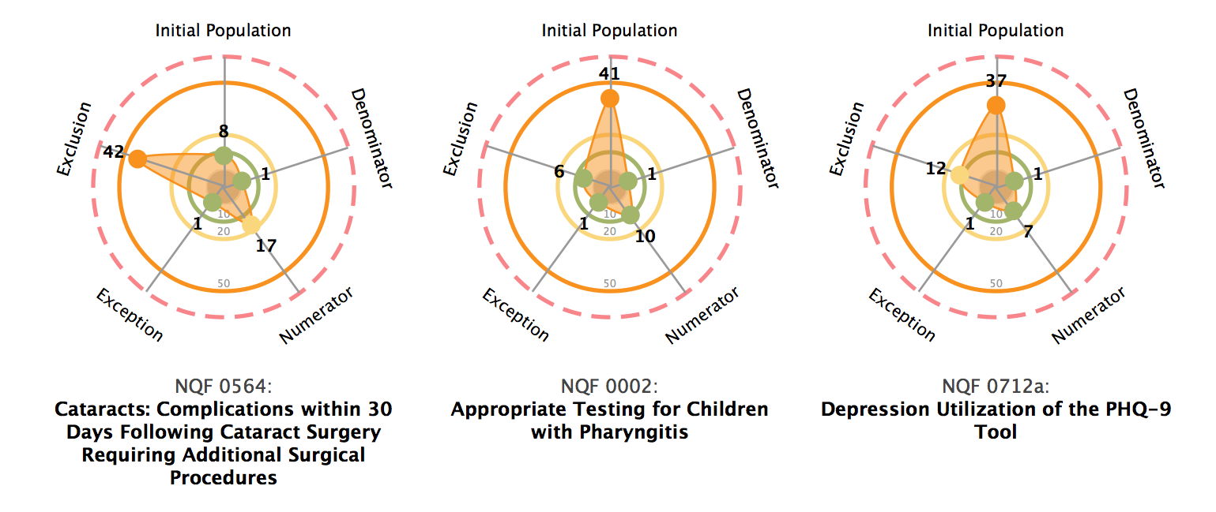
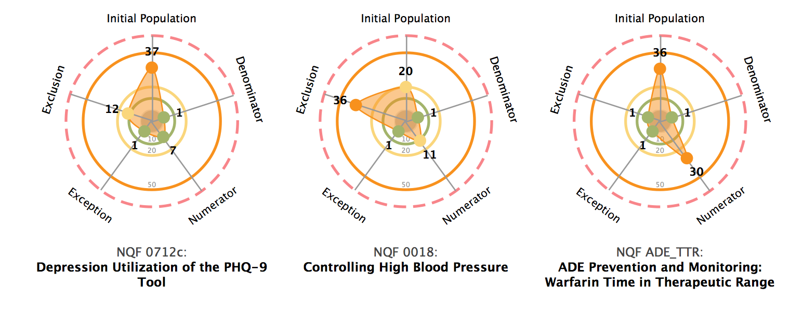
MU Stage 2 Cyclomatic Complexity Results

Slide 27
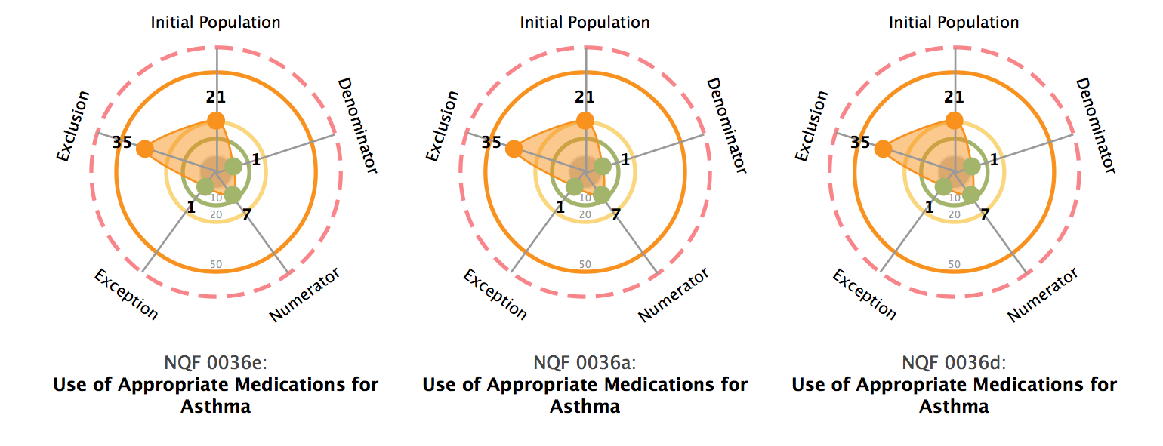
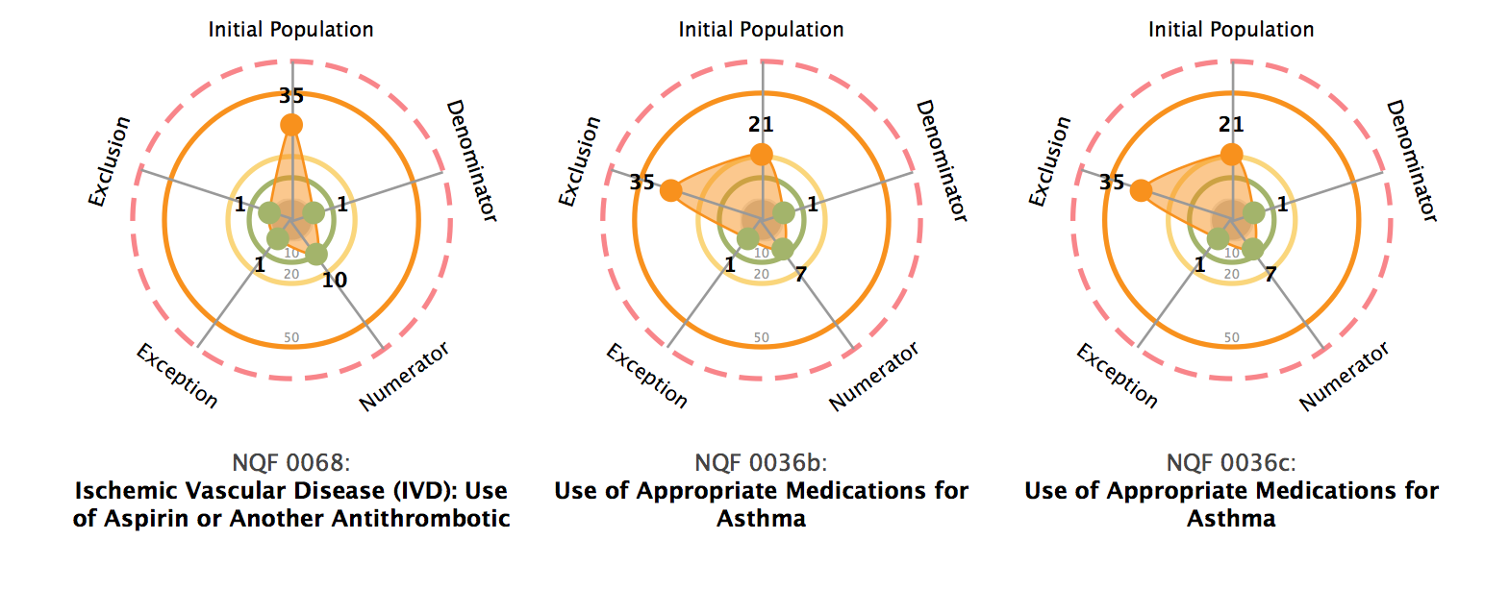
MU Stage 2 Cyclomatic Complexity Results

Slide 28
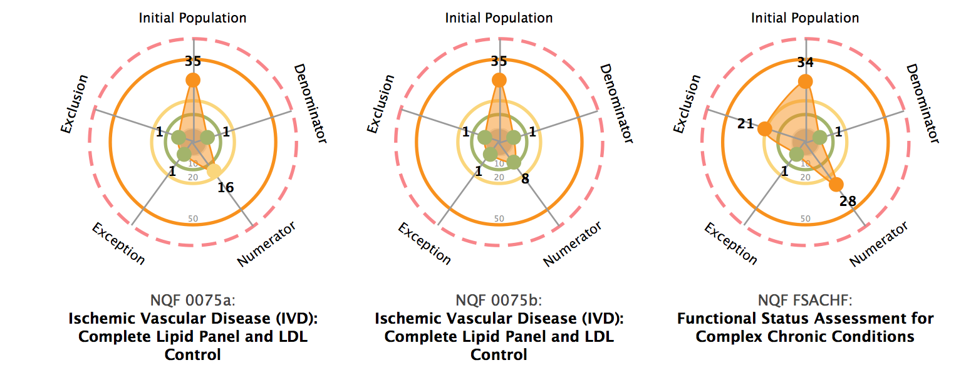
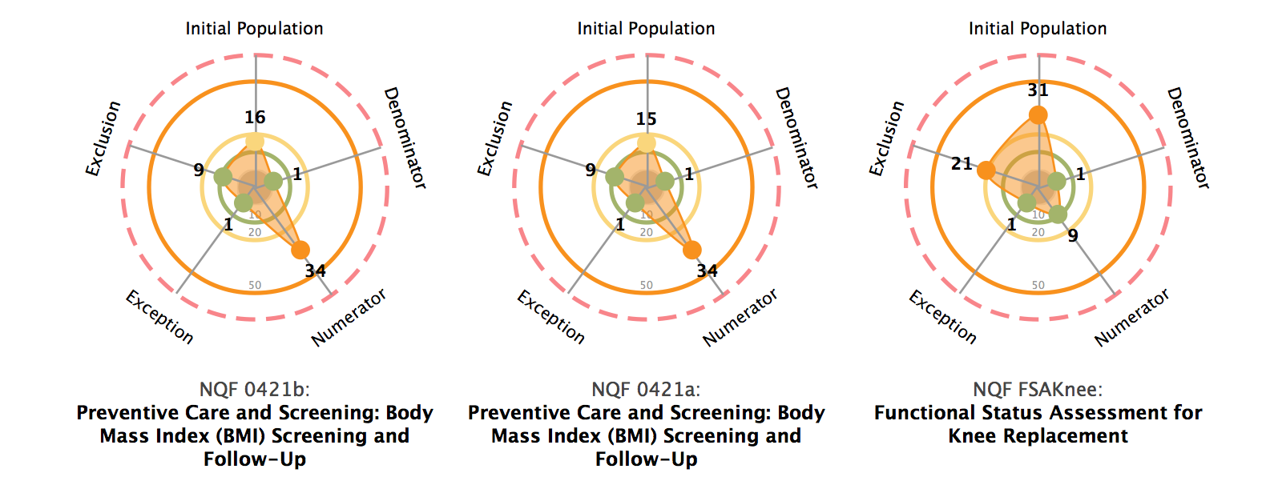
MU Stage 2 Cyclomatic Complexity Results

Slide 29
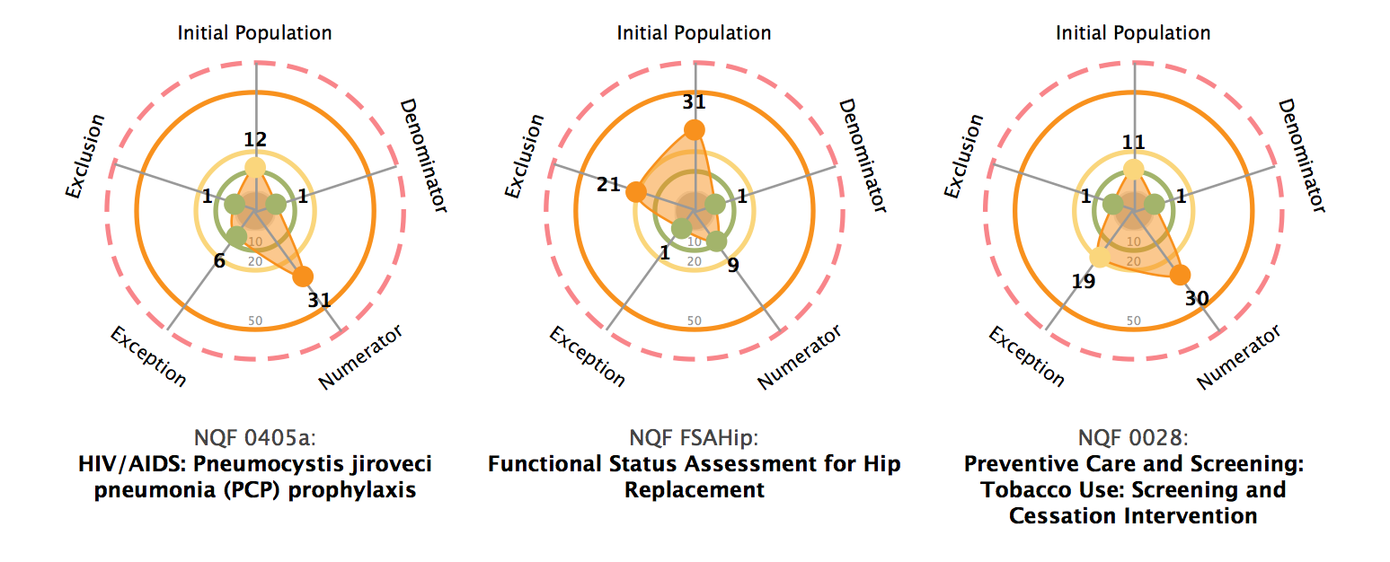
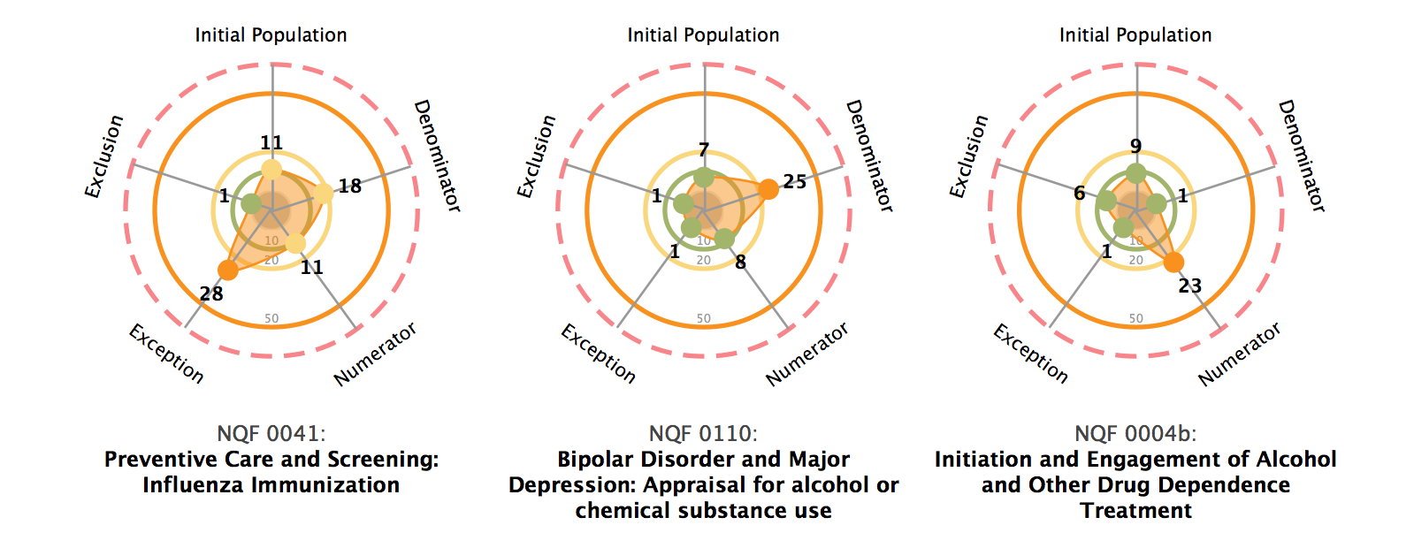
MU Stage 2 Cyclomatic Complexity Results

Slide 30
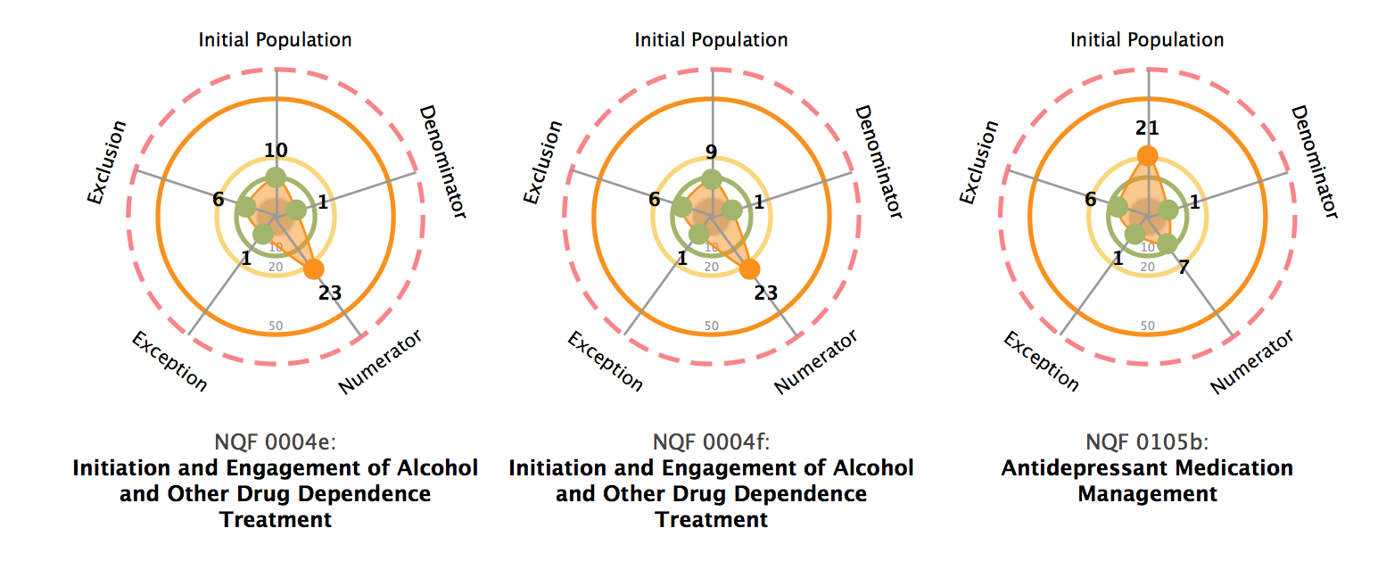
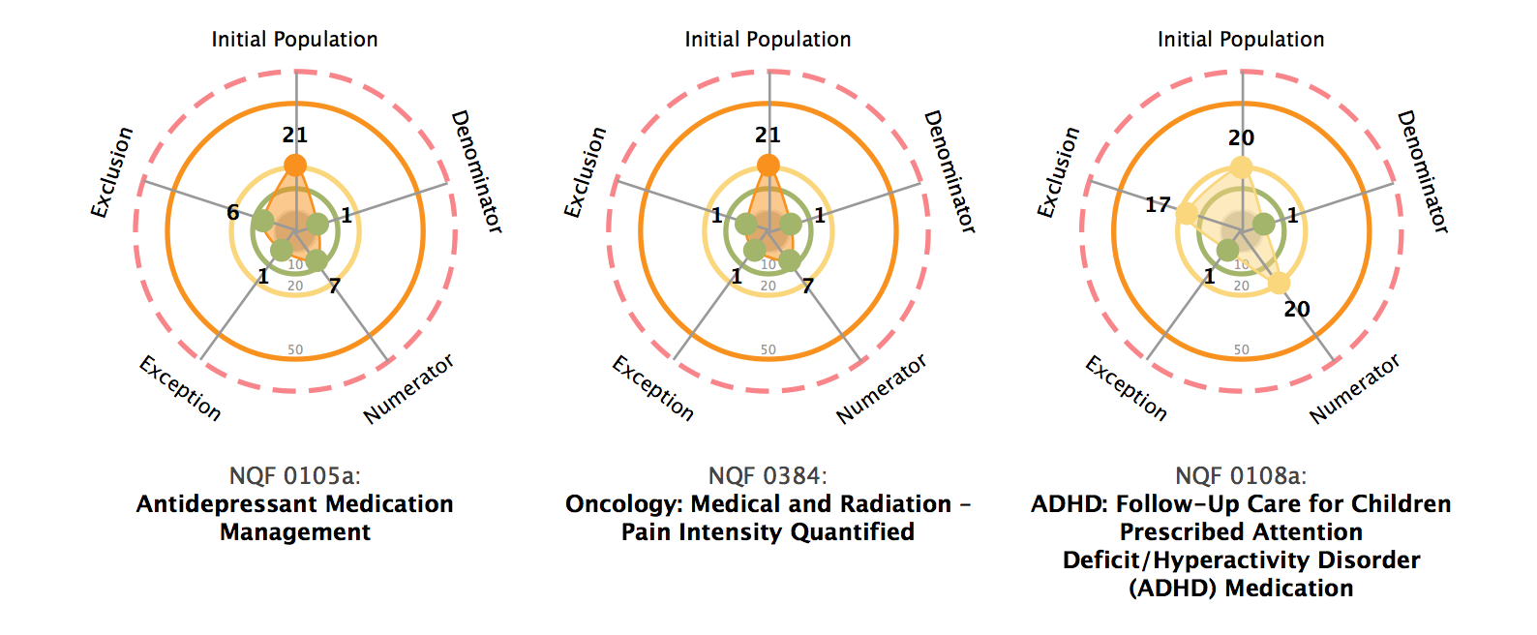
MU Stage 2 Cyclomatic Complexity Results

Slide 31
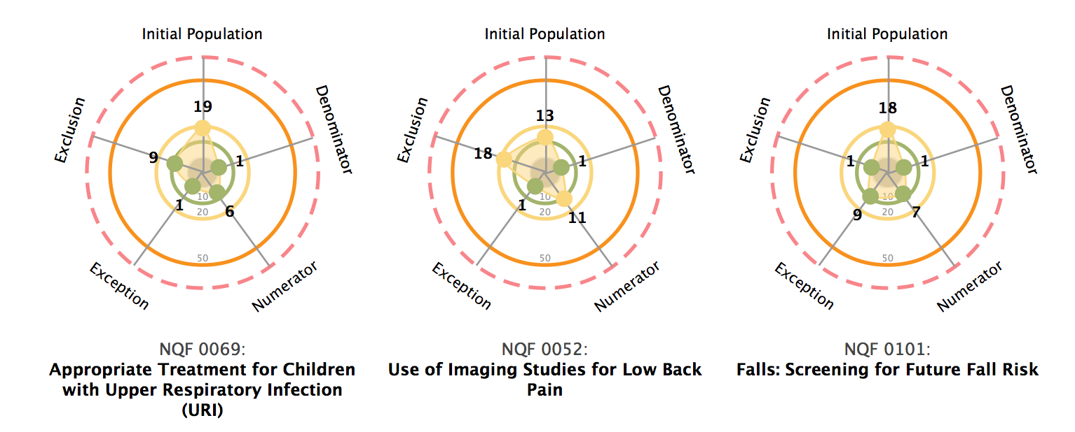
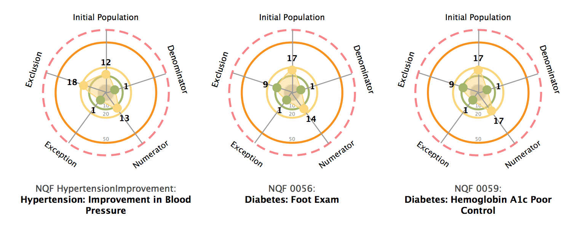
MU Stage 2 Cyclomatic Complexity Results

Slide 32
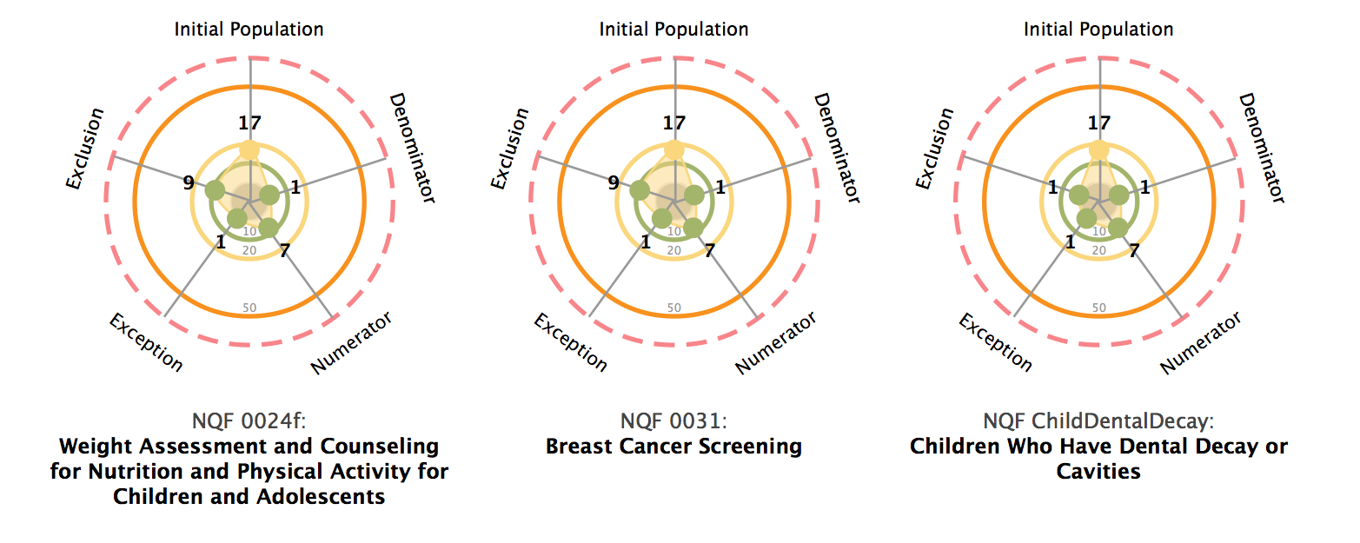
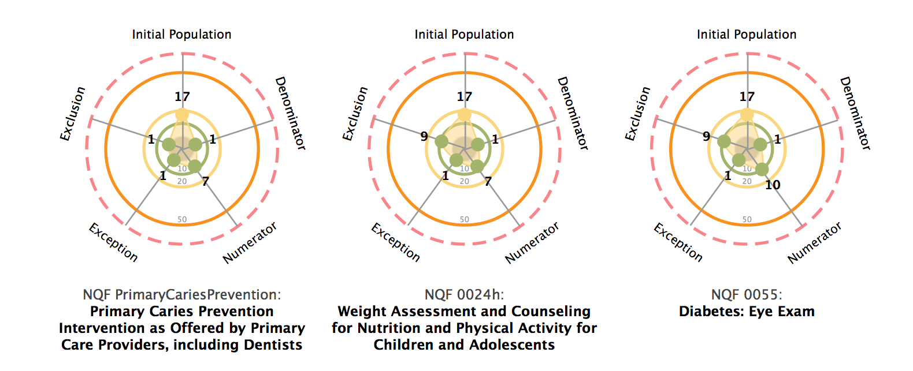
MU Stage 2 Cyclomatic Complexity Results

Slide 33
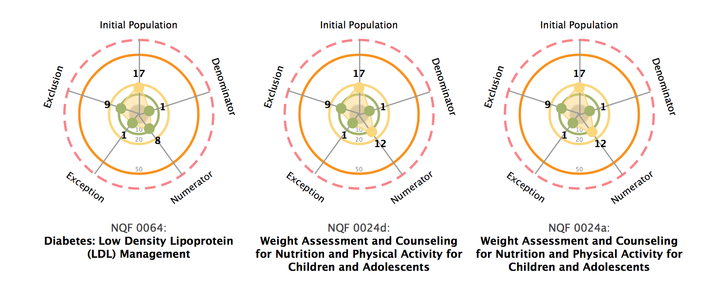
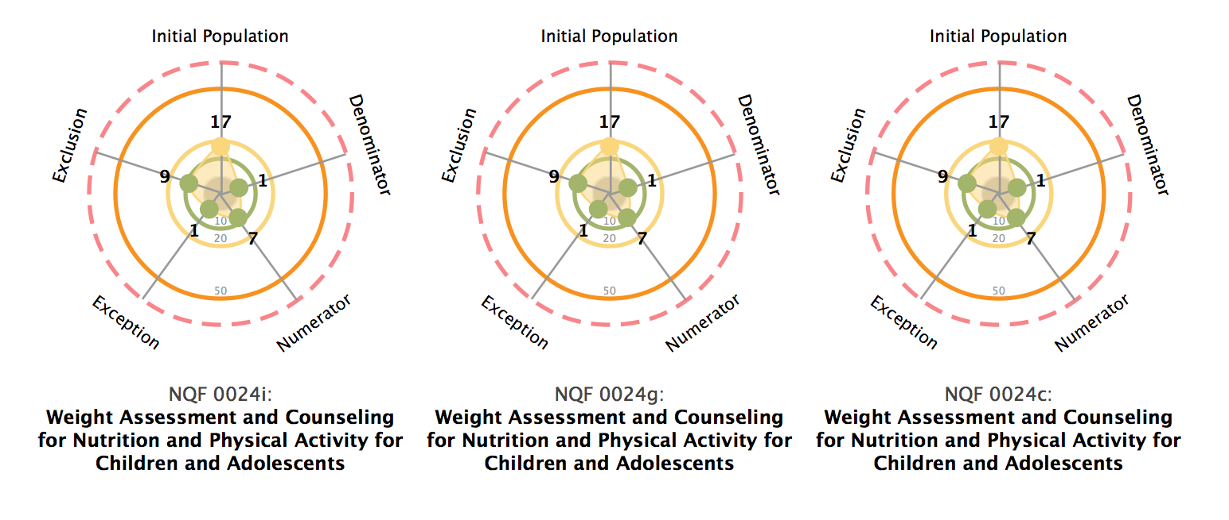
MU Stage 2 Cyclomatic Complexity Results

Slide 34
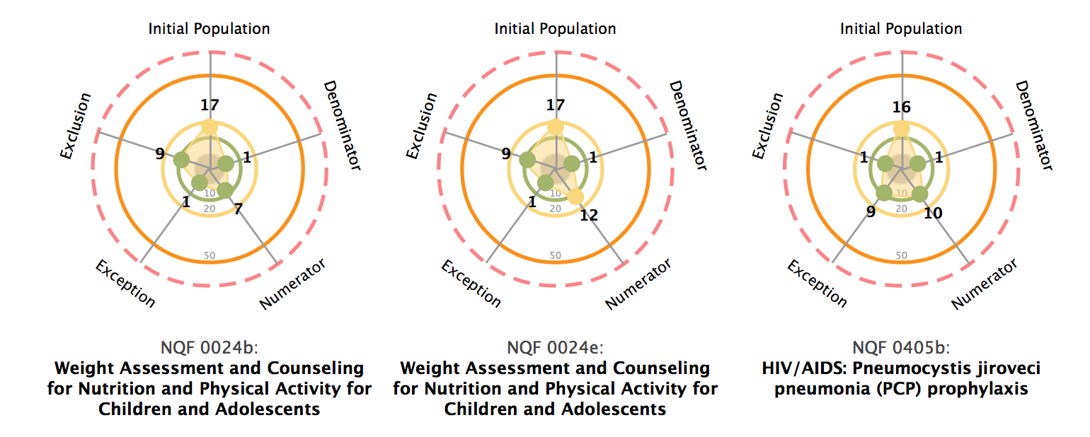
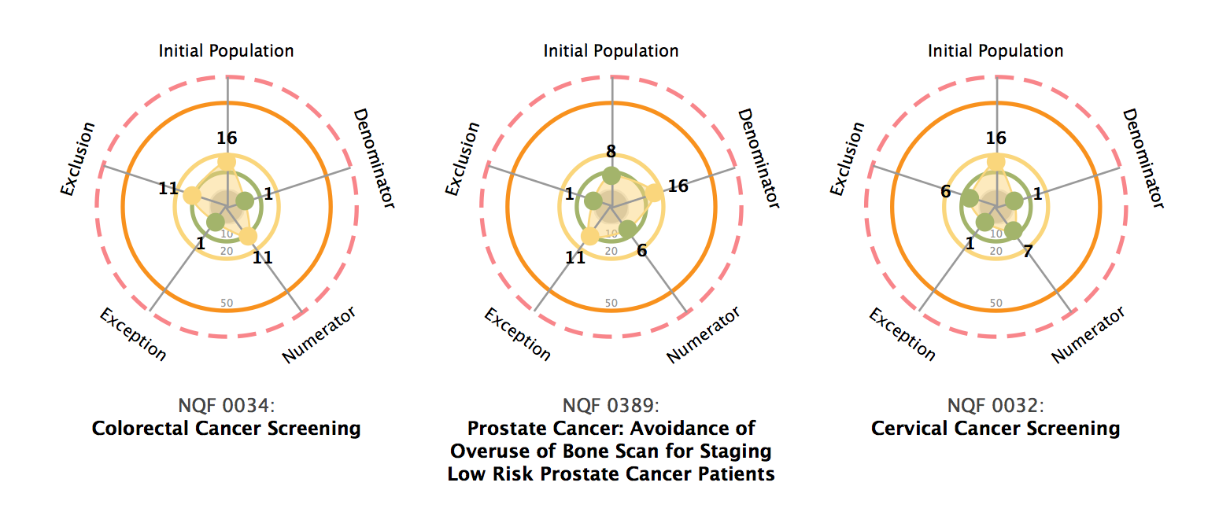
MU Stage 2 Cyclomatic Complexity Results

Slide 35
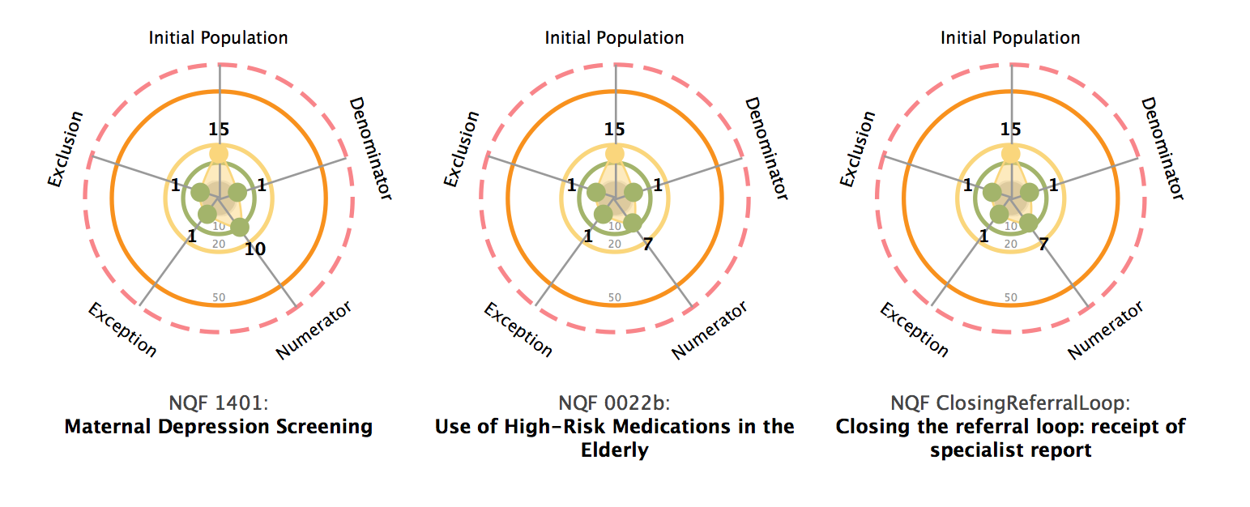
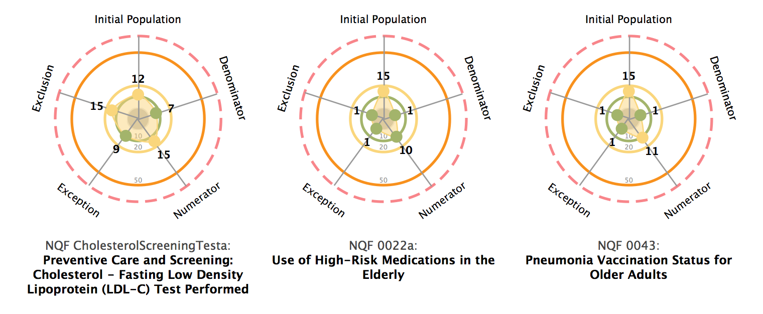
MU Stage 2 Cyclomatic Complexity Results

Slide 36
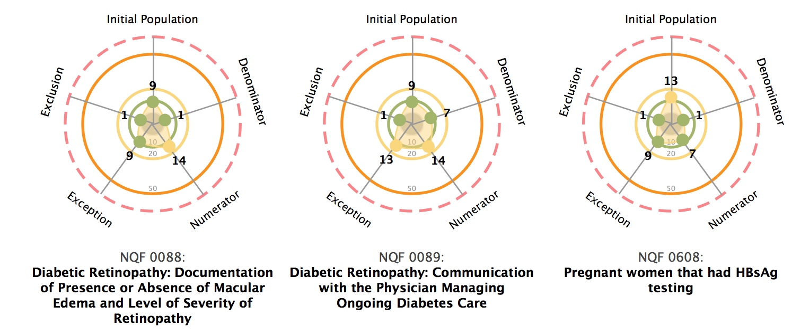
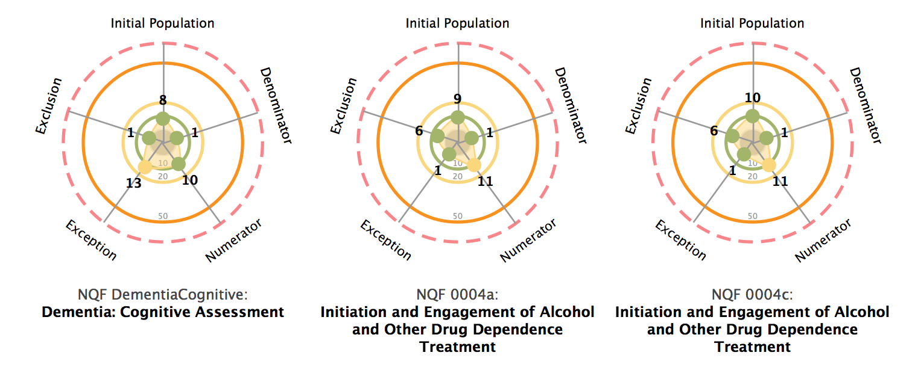
MU Stage 2 Cyclomatic Complexity Results

Slide 37
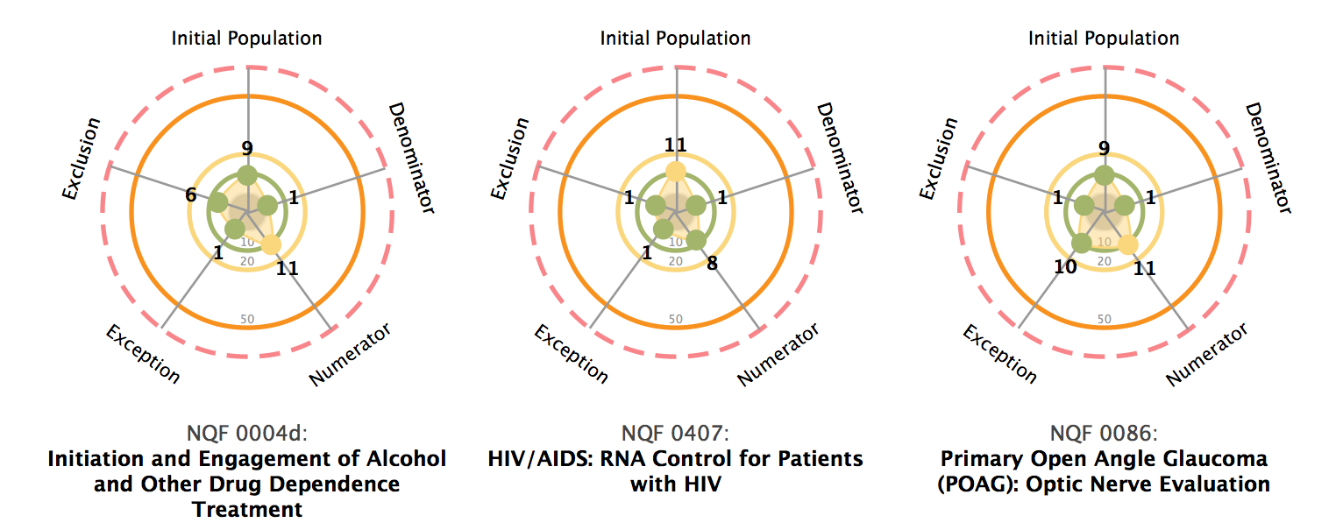
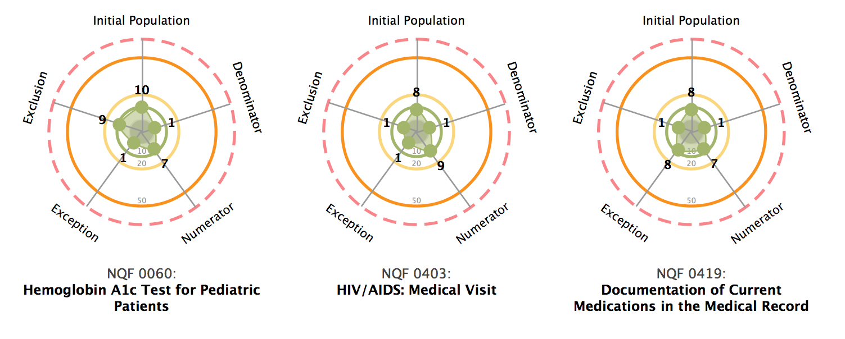
MU Stage 2 Cyclomatic Complexity Results

